Slide 1
Application of Steerable Filter and Multi-attribute Display in Crack Detection of 2D/3D Seismic Coherence Data
Speaker: Liao.L
Tutor: Zhenming Peng & Bingjie Tao
IDIPLAB · UESTC

Slide 2
Introduction
Method
Experiment*
Conclusion

Slide 3
1.1 Edge detection
Crack detection belongs to edge detection.
Edge detection includes a variety of mathematical methods that aim at identifying points in a digital image at which the image brightness changes sharply or, more formally, has discontinuities.
-- Wikipedia
mid-level
Pixel-level
Segmentation
Representation
&
Description
Object-level
high-level
Preprocessing
Knowledge
Based
(Image analysis system)
Recognition
&
Interpretation
Res.
low-level
Prob.
Acquisition

Slide 4
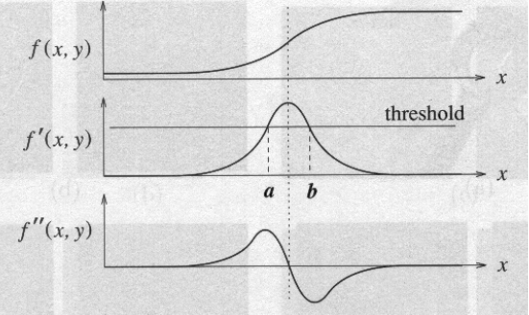
1.2 Classic Edge detection Algorithm
Points which lie on an edge can be detected by:
(1) detecting local maxima or minima of the first derivative
(2) detecting the zero-crossing of the second derivative
Filtering to approximate first derivative
Computation of gradient magnitude
Thresholding
Input image
(grayscale)
(1)
Output image
(binary)
(2)
Smoothing
Filtering to approximate second derivative
Zero-Crossing (with threshold)

Slide 5
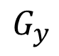
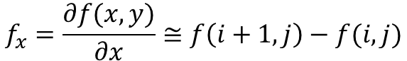
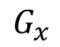
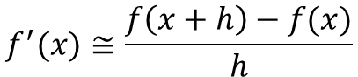
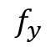
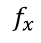
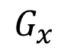
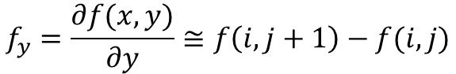
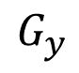
1.2 Classic Edge detection Algorithm
Roberts (1963)
$$f^{′}(x)≅\frac{f\left(x+h\right)−f(x)}{h}$$
[-1] | 0
0 | 1
0 | [-1]
1 | 0
$$f_{x}=\frac{∂f(x,y)}{∂x}≅f\left(i+1,j\right)−f(i,j)$$
-1 | 1
$$f_{x}$$
$$f_{y}=\frac{∂f(x,y)}{∂y}≅f\left(i,j+1\right)−f(i,j)$$
-1
1
$$f_{y}$$
Prewitt (1970)
Sobel (1970)
-1 | 0 | 1
-1 | 0 | 1
-1 | 0 | 1
-1 | [0] | 1
-1 | 0 | 1
-1 | -1 | -1
0 | [0] | 0
1 | 1 | 1
-1 | 0 | 1
-2 | [0] | 2
-1 | 0 | 1
-1 | -2 | -1
0 | [0] | 0
1 | 2 | 1
1
1
1
1
2
1
$$G_{x}$$
$$G_{y}$$
$$G_{x}$$
$$G_{y}$$

Slide 6
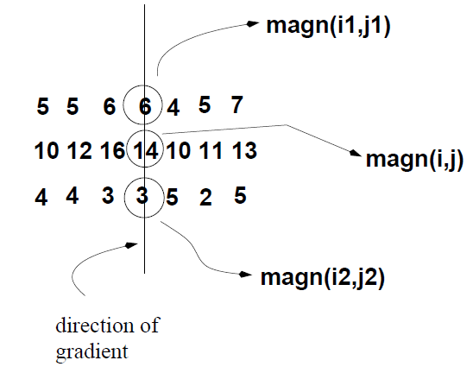
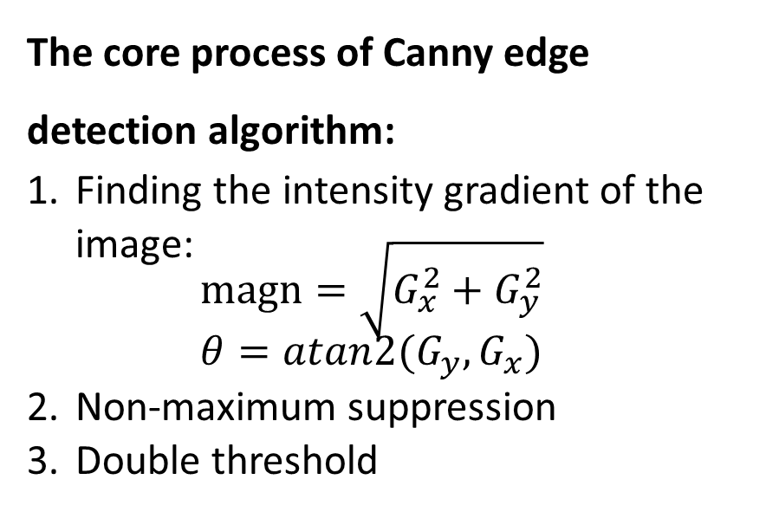
1.2 Classic Edge detection Algorithm
All value along the direction of the gradient that are not peak values of a ridge are suppressed.
Canny (1986)
The core process of Canny edge detection algorithm:
Finding the intensity gradient of the image: $magn=\sqrt{G_{x}^{2}+G_{y}^{2}}$ $θ=atan2(G_{y},G_{x})$
Non-maximum suppression
Double threshold
weak edge pixel
0
1
non-edge pixel
strong edge pixel

Slide 7
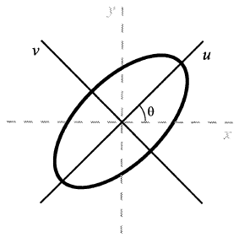

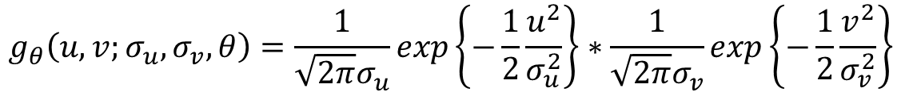
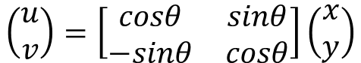
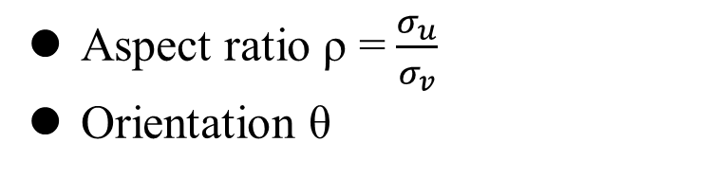
1.3 Direction Constrained Gaussian Filtering
$$g_{θ}\left(u,v;σ_{u},σ_{v},θ\right)=\frac{1}{\sqrt{2π}σ_{u}}exp\left\{−\frac{1}{2}\frac{u^{2}}{σ_{u}^{2}}\right\}∗\frac{1}{\sqrt{2π}σ_{v}}exp\left\{−\frac{1}{2}\frac{v^{2}}{σ_{v}^{2}}\right\}$$
$$\left(\begin{matrix}u \\ v\end{matrix}\right)=\left[\begin{matrix}cosθ & sinθ \\ −sinθ & cosθ\end{matrix}\right]\left(\begin{matrix}x \\ y\end{matrix}\right)$$
Aspect ratio ρ =$\frac{σ_{u}}{σ_{v}}$
Orientation θ
ρ and θ control the direction of Gaussian filtering
Problem: Every orientation needs a filter, which is complicated and time consuming.

Slide 8
Introduction
Method
Experiment
Conclusion

Slide 9
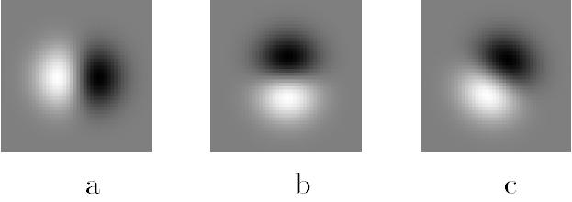
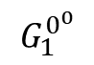
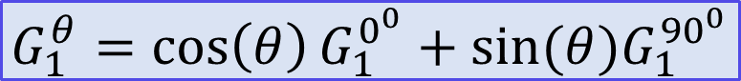
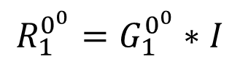
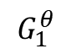
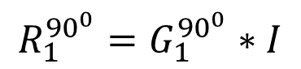
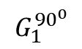
Freeman W T, Adelson E H. The design and use of steerable filters[J]. IEEE Transactions on Pattern Analysis & Machine Intelligence, 1991 (9): 891-906.
2.1 Steerable Filter
$$G_{1}^{θ}=\cos\left(θ\right)G_{1}^{0^{0}}+sin⁡(θ)G_{1}^{{90}^{0}}$$
Convolution is a linear operation
x=au, y=bv.
$$R_{1}^{0^{0}}=G_{1}^{0^{0}}∗I$$
$$R_{1}^{θ}=G_{1}^{θ}∗I={\cos\left(θ\right)R}_{1}^{0^{0}}+{\sin\left(θ\right)R}_{1}^{0^{0}}$$
$$R_{1}^{{90}^{0}}=G_{1}^{{90}^{0}}∗I$$
Y
(x,y)
v
$$G_{1}^{0^{0}}$$
$$G_{1}^{{90}^{0}}$$
$$G_{1}^{θ}$$
u
X

Slide 10
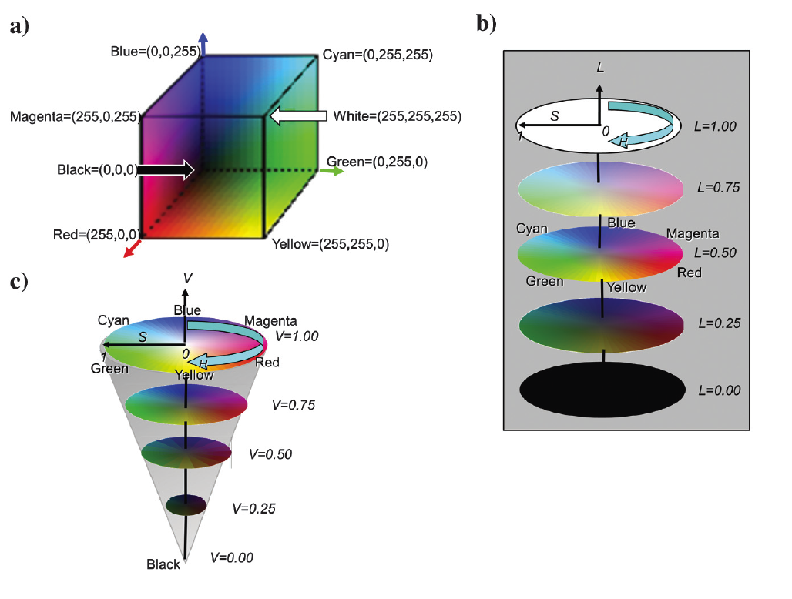
2.2 HLS color models
Marfurt K J. Techniques and best practices in multiattribute display[J]. Interpretation, 2015, 3(1): B1-B23.
HSV: hue-saturation-value
HLS: hue-lightness-saturation
Multi-attribute Display: Different attributes correspond to different color channels in HLS.
e.g. orientation corresponds to hue
edge corresponds to lightness
saturation is set to 1
(a)RGB (b)HLS (c)HSV

Slide 11
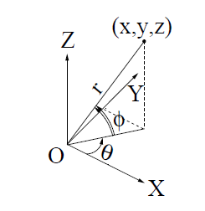
2.3 3D flow chart
(H)
(L)

Slide 12
Introduction
Method
Experiment
Conclusion

Slide 13
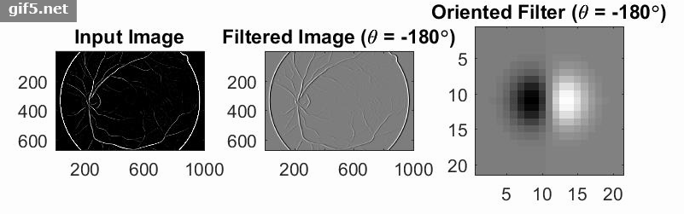
3.1 2D Steerable Filter

Slide 14
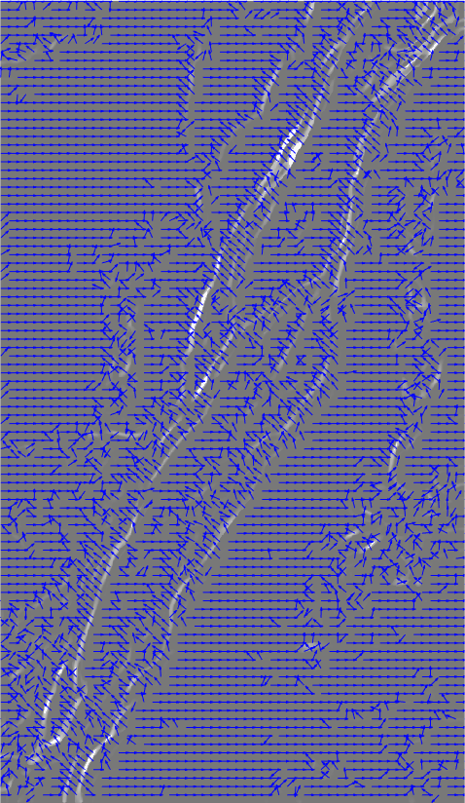
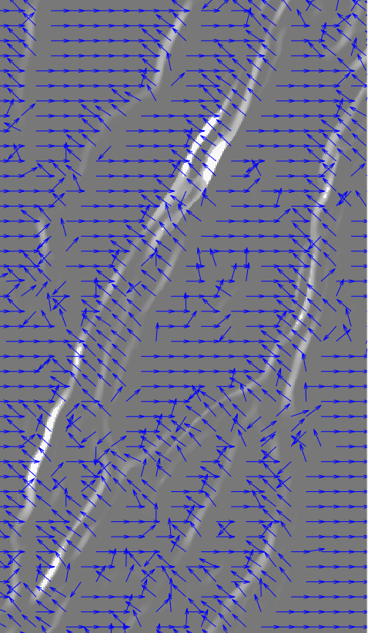
二维矢量化

Slide 15
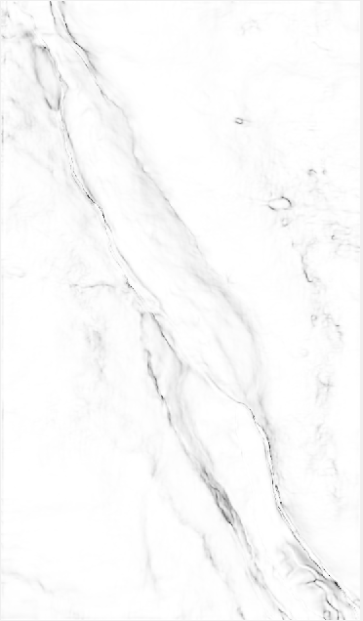
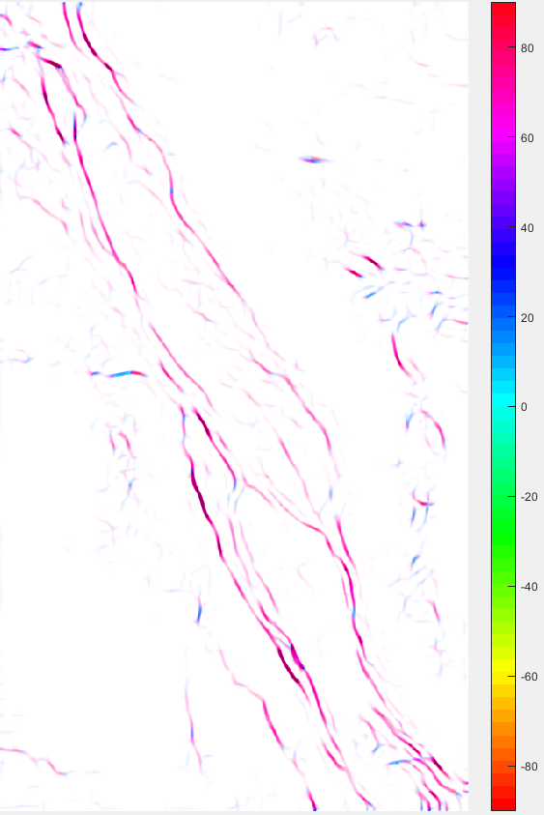
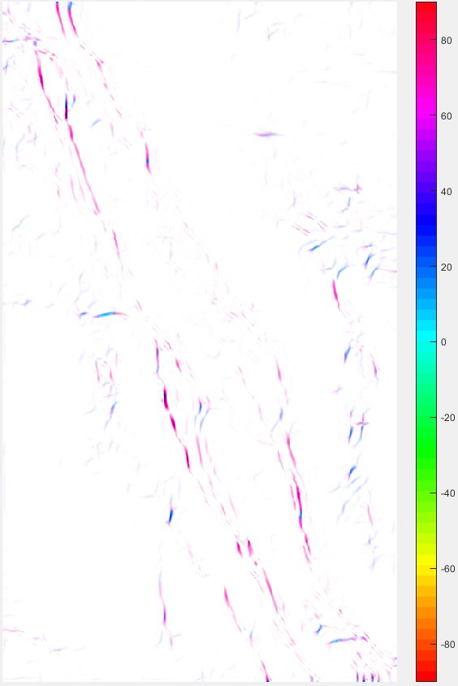
原图
不带方向约束
去除θ=-60方向的裂缝

Slide 16
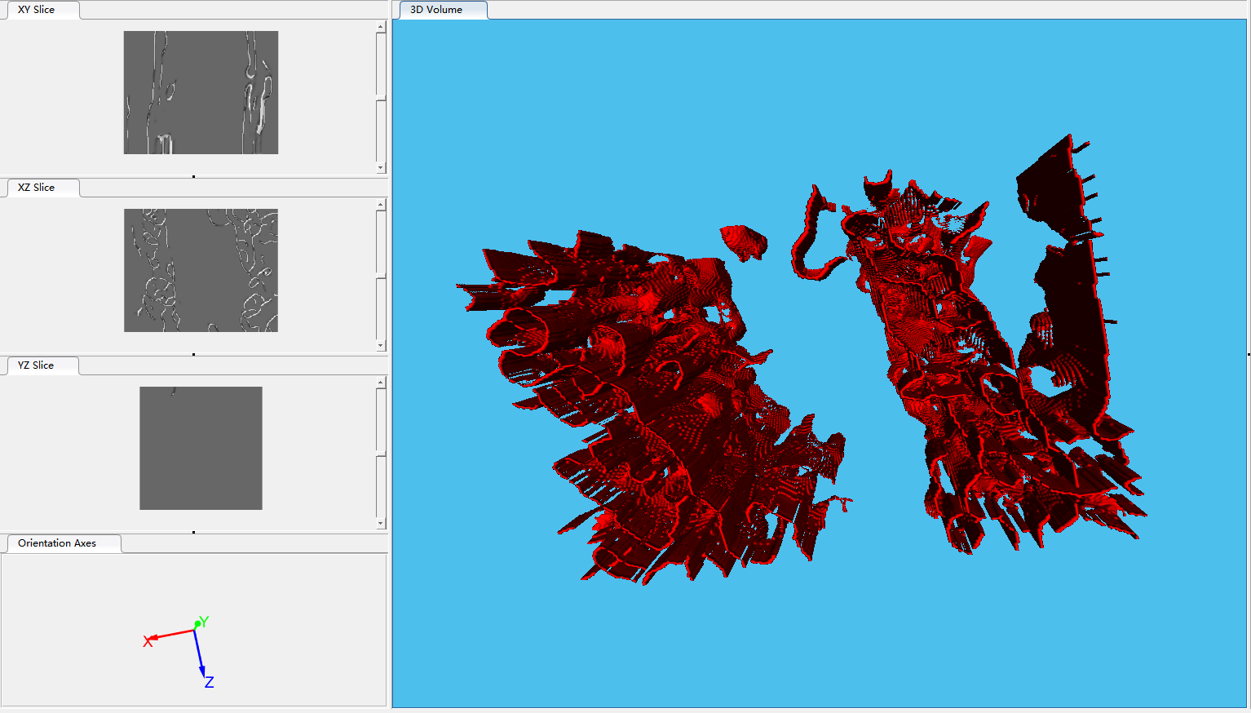
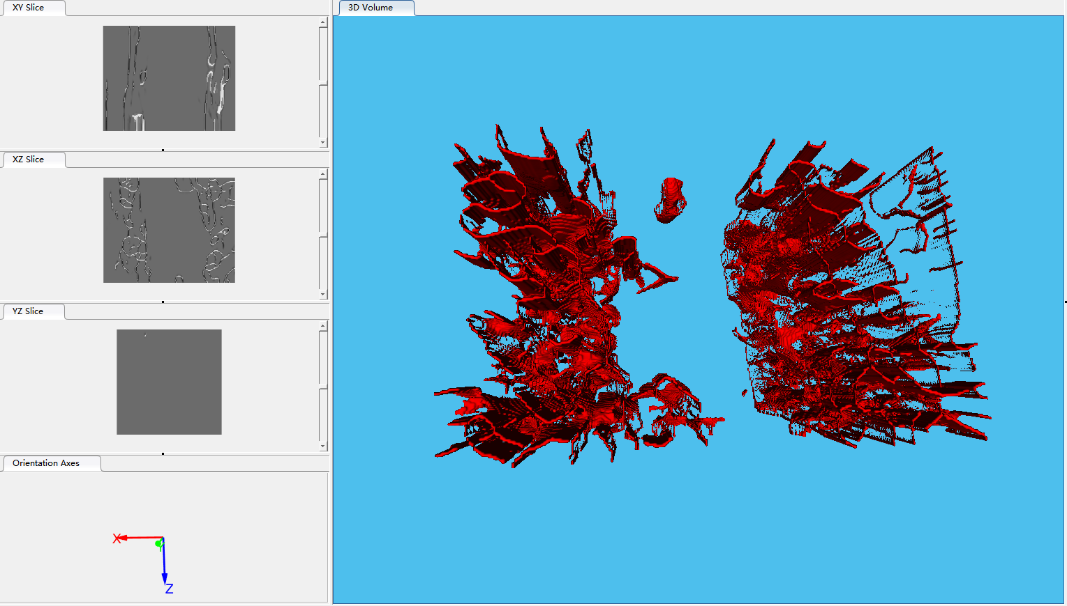
3.2 3D Steerable Filter
不带方向约束
去除θ=0，φ=90方向的裂缝

Slide 17
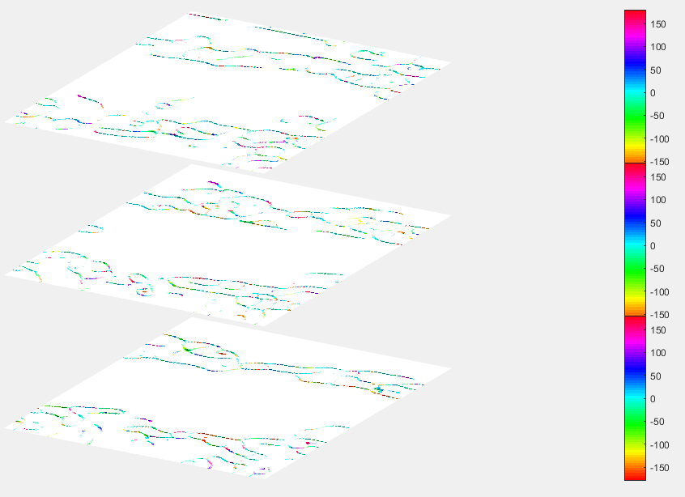
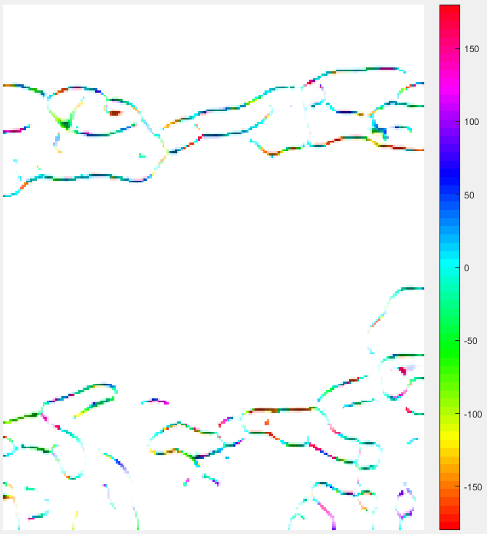
3.2 3D Steerable Filter
裂缝倾角θ显示

Slide 18
Introduction
Method
Implementation
Conclusion

Slide 19
4. conclusion
The main work :
Implemented 3D orientation filter
Completed 3D fault/crack model reconstruction
Realized multi-attribute fusion display
Next plan:
Code portability
Project acceptance

Slide 20
Extra content

Slide 21
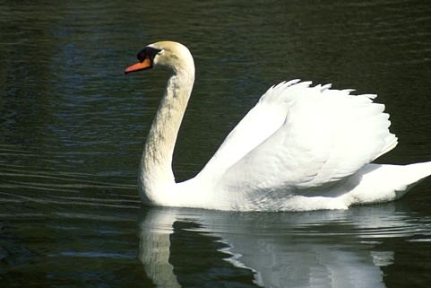
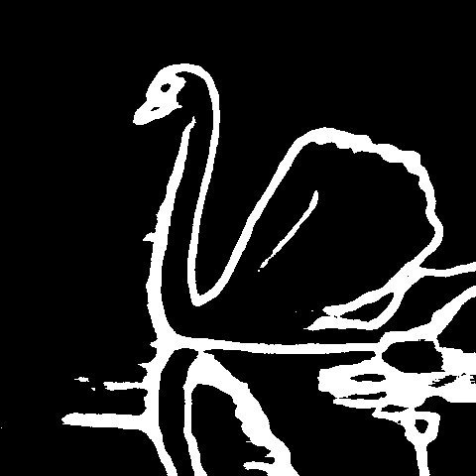
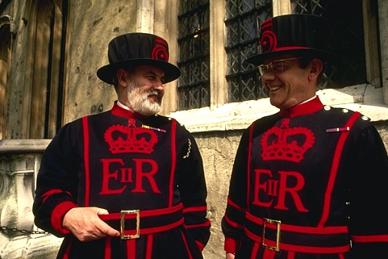
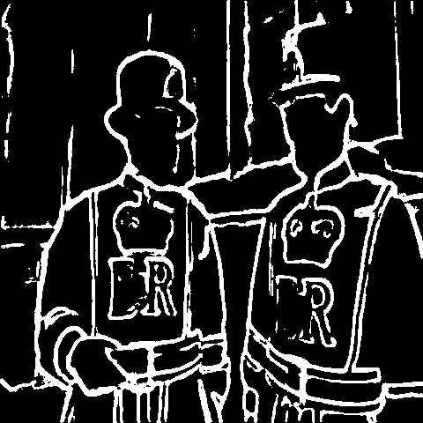
E1 HED

Slide 22

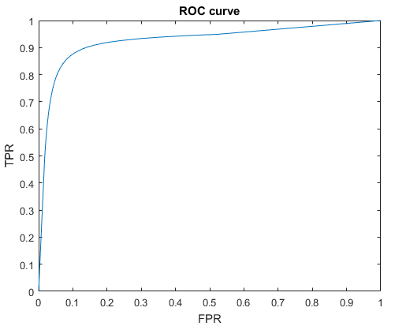
E2 ROC
https://github.com/LiaoLIDIP/NewROC

Slide 23
THANKS
https://github.com/LiaoLIDIP/Report-IDIPLab

